Slide 1
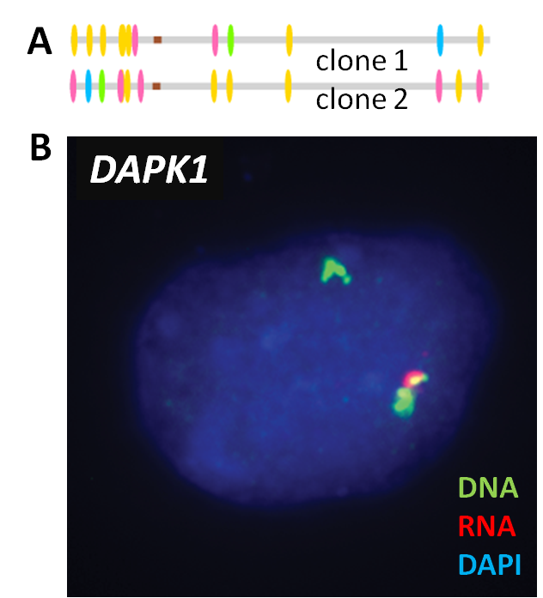





MaGIC 2.0: Epigenetic marks identify monoallelic expression
Sachit Saksena | Henry Ward | Sébastien Vigneau | Alexander A. Gimelbrant

Slide 2
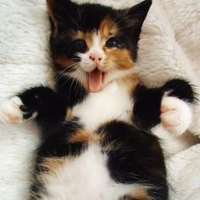

Monoallelic expression (MAE) – “autosomal analog of X chromosome inactivation”
X-chromosome inactivation is a process by which one copy of an X chromosome in a female is inactivated via random chromosome choice
Monoallelic expression is a process by which one allele in an autosomal cell is inactivated via random allelic choice
Genes can be monoallelic (MAE) or biallelic (BAE) – in which both alleles are expressed
Gimelbrant et al. 2007
Notes:
Monoallelic expression explanation + relevance. Focus on that it is an analog of X-chromosome inactivation (autosomal genes)
3

Slide 3
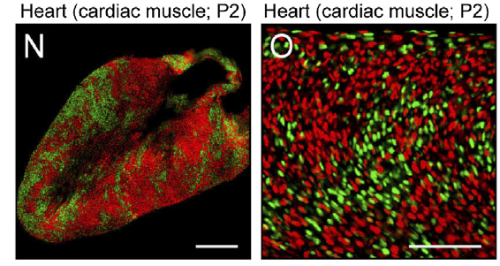
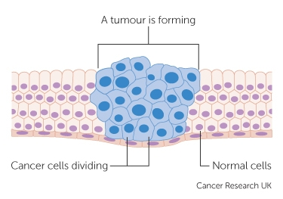
Epigenetic mechanisms controlling allele-specific expression can lead to dramatic variation
RNA analysis in bulk cells
MAE can not be identified by analyzing mosaic expression of cells
FISH (RNA visualization)
Cannot assess whole genome
Single cell RNA-Seq
Only captures very highly expressed genes
Noisy data leads to large number of false positives
Wu et al, 2014 – X chromosome inactivation
UK Cancer Research Center
Notes:
Epigenetic mechanisms like X-chromosome inactivation have been identified as highly important in variation, and since autosomal genes are more widely expressed, MAE affects variation
Explain the picture more all elements
Show only heart and show an example of cells giving rise to cancer to
3

Slide 4
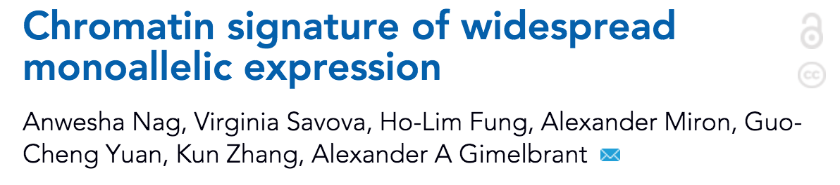
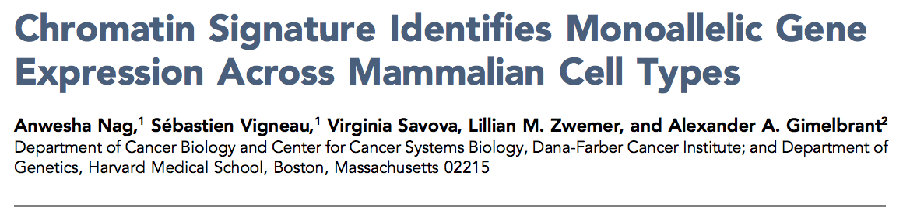
A new way to identify MAE
Notes:
Papers by our lab that were important in discovering a new way to
1

Slide 5
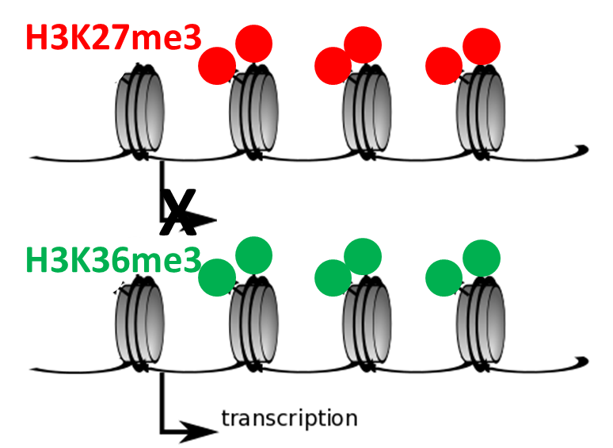
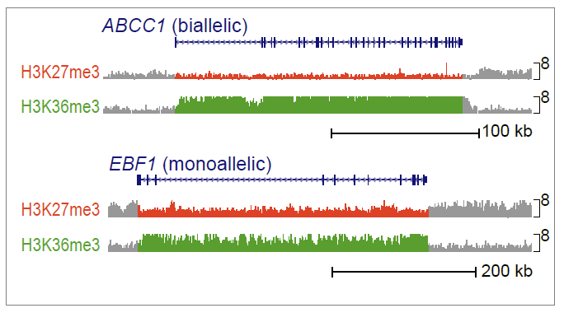
Chromatin signature is a sequence-independent proxy of MAE
Specific chromatin signatures are associated with epigenetic activation and silencing
transcription
Specific chromatin signatures are also associated with monoallelic or biallelic expression
Nag, Savova et al., 2013
Notes:
Chromatin signature is a proxy for monoallelic expression. This is intuitive because certain chromatin marks are, in fact, associated with epigenetic silencing or activation.
3

Slide 6
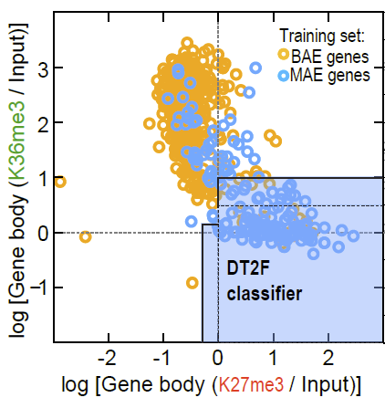
Chromatin signature can reliably predict MAE: A MaGIC Classifier
Mono-
Allelic
Gene Inference from Chromatin
Notes:
Explain the old MaGIC classifier
1

Slide 7
Predicted
Biallelic
Predicted Monoallelic
Alternating decision tree using 2 features: H3k27me3 and H3k36me3
Trained on human B-cell dataset
73% accurate overall
Issues: misses many MAE genes by classifying as BAE
Research question: Can MaGIC become more magical?
Notes:
Analyzing the performance of the original MaGIC classifier: it’s strong suits and its pitfalls
2

Slide 8
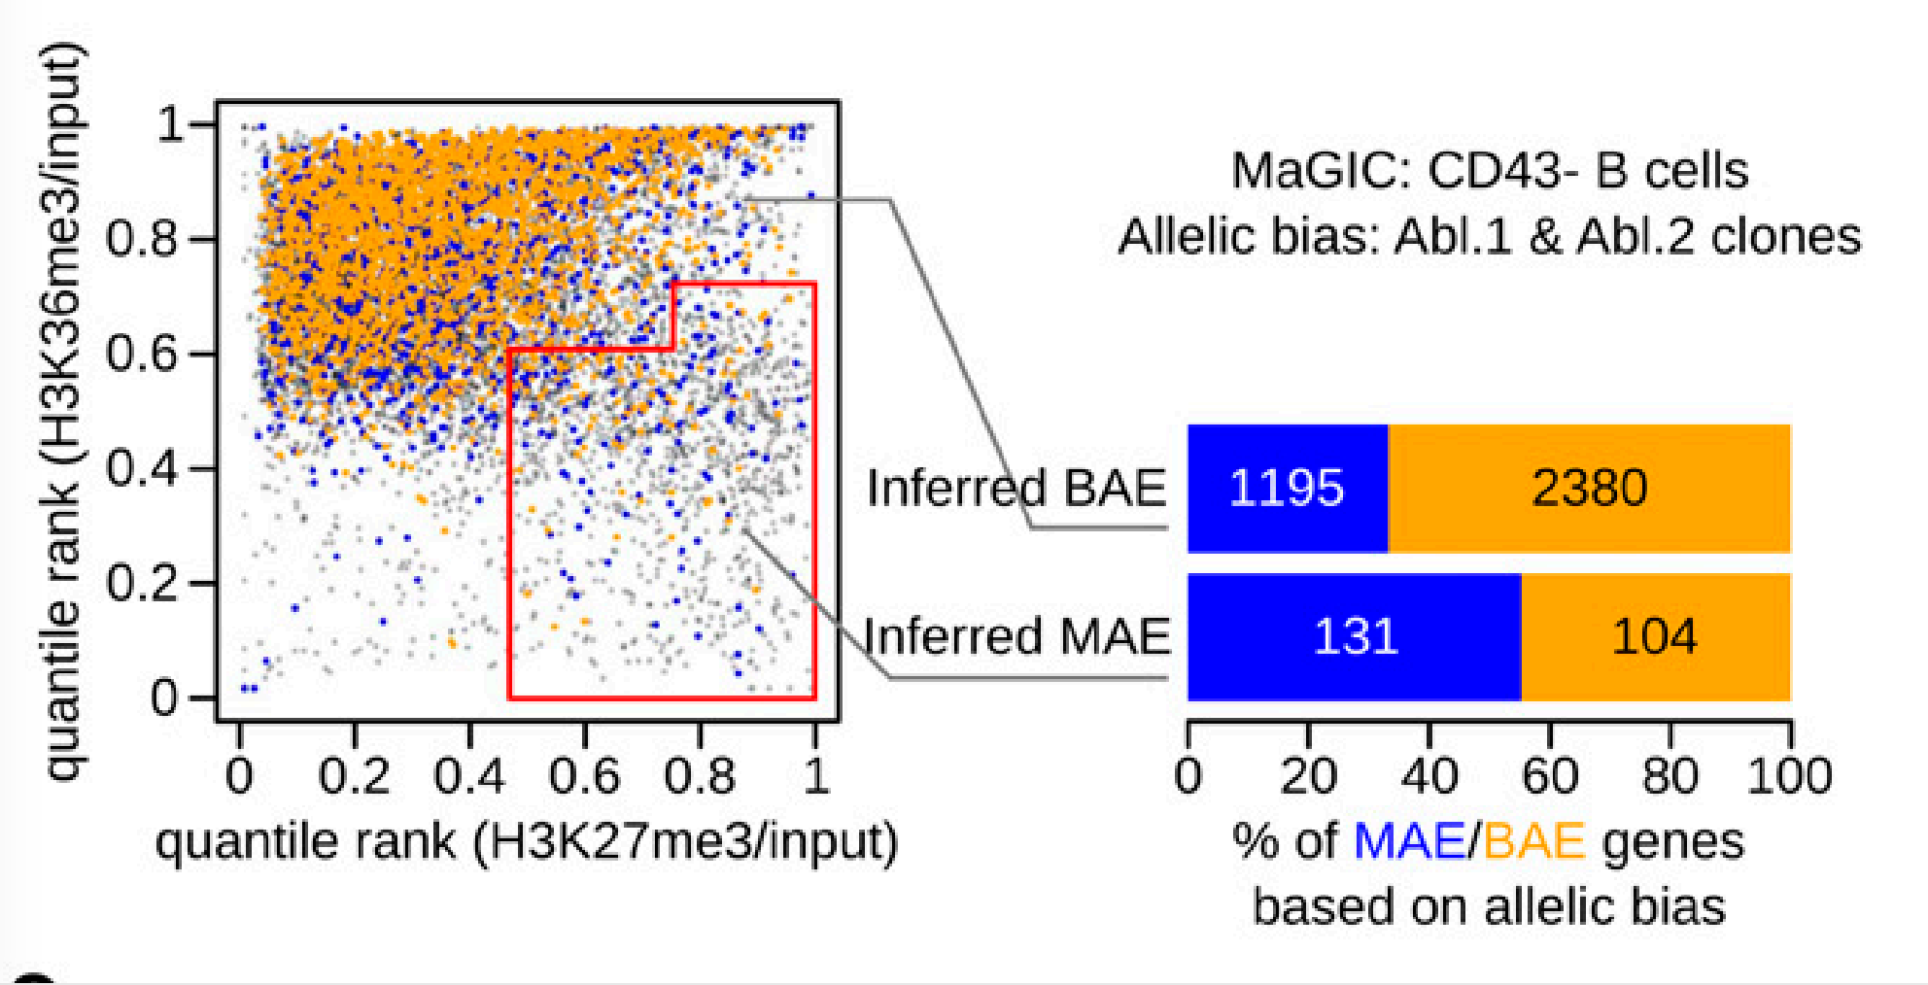
Research question: What epigenetic features explain MAE genes classified as BAE?
Many MAE genes classified as BAE
Notes:
First question: can we somehow biologically explain why some genes fall outside of the partition between
3

Slide 9
Summer Goals
MaGIC 1.0
Trained on limited human data
Only evaluated a single silencing mark (H3K27me3)
Messy user-interface and pipeline
Train on better data from mice
Add additional features to improve classification accuracy and draw conclusions
Create an updated machine learning model and package it into user-friendly software for widespread use
Notes:
Train a machine learning classification algorithm on better data
Add additional predictors that may improve classification accuracy and further explain MAE/BAE
Create an updated machine learning model and package it into a
CURRENT STATE VS GOALS
MAGIC 1.0: Trained on human data, works on mouse, trained on only one silencing mark, very “not user friendly”
GOALS: train on mouse data, train on additional set of features with more silencing marks, create a user-friendly pipeline

Slide 10
Summer Goals
MaGIC 1.0
Trained on limited human data
Only included one silencing mark (H3K27me3)
Messy user-interface and pipeline
Train on better data from mice
Add additional features to improve classification accuracy and draw conclusions
Create an updated machine learning model and package it into user-friendly software for widespread use
Notes:
Train a machine learning classification algorithm on better data
Add additional predictors that may improve classification accuracy and further explain MAE/BAE
Create an updated machine learning model and package it into a
CURRENT STATE VS GOALS
MAGIC 1.0: Trained on human data, works on mouse, trained on only one silencing mark, very “not user friendly”
GOALS: train on mouse data, train on additional set of features with more silencing marks, create a user-friendly pipeline

Slide 11
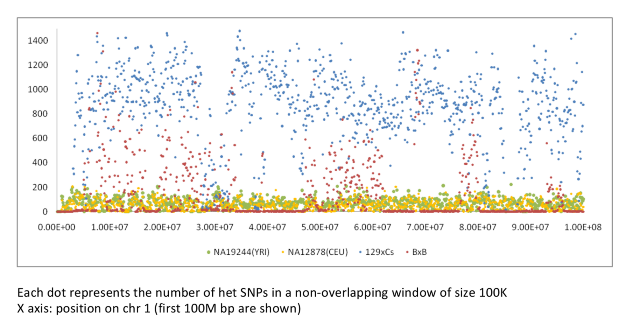
Why are F1 hybrid mouse samples better? SNPs.
SNP
Density
Notes:
Mouse data is better because it has more SNPs per 100K base pairs, which allows for better coverage and therefore a better allelic bias call. The red and blue dots are density of SNPs in mouse clones and the green and yellow dots are density of SNPs in human cclones
Remember to include mice, F1 hybrid,
Remember to explain what the axis is, include much higher allelic
1

Slide 12
Training genes
Mouse data produced in Nag et al. 2015 and Zwemer et al. 2013
RNA-Seq and microarray data on clonal mouse primary B-cells
rMAE/BAE status criteria
random MAE (rMAE gene): if MAE in at least one clone and MAE from the opposite allele, or BAE in at least one other clone
BAE gene: if BAE in all clones, not MAE in any clone
Confounding low expression and silent genes filtered out
Filtered X-chromosome, imprinted genes and olfactory receptor genes
Notes:
Emphasize that MAE is monoallelic expression and BAE is bioallelic expression (literal acronyms)
3
Why filter olfactory genes? SO MANY OF THEM, they should be silent everywhere except olfactory neurons, and they are really short

Slide 13
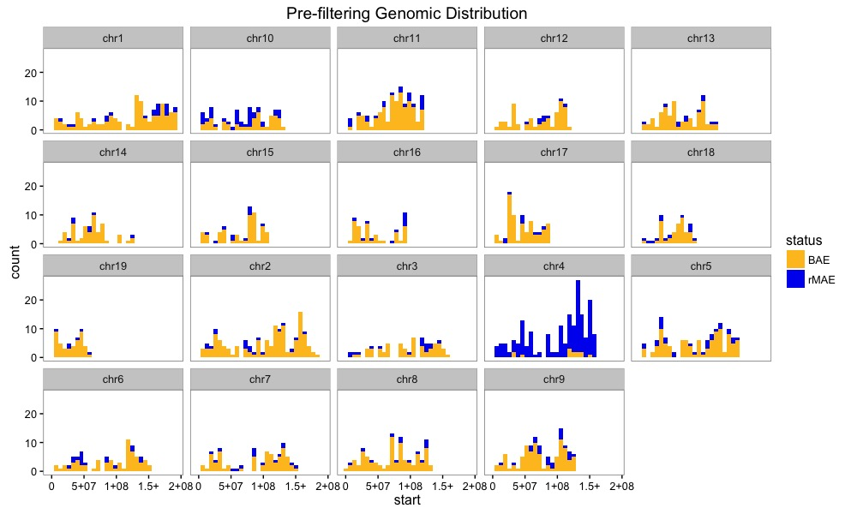
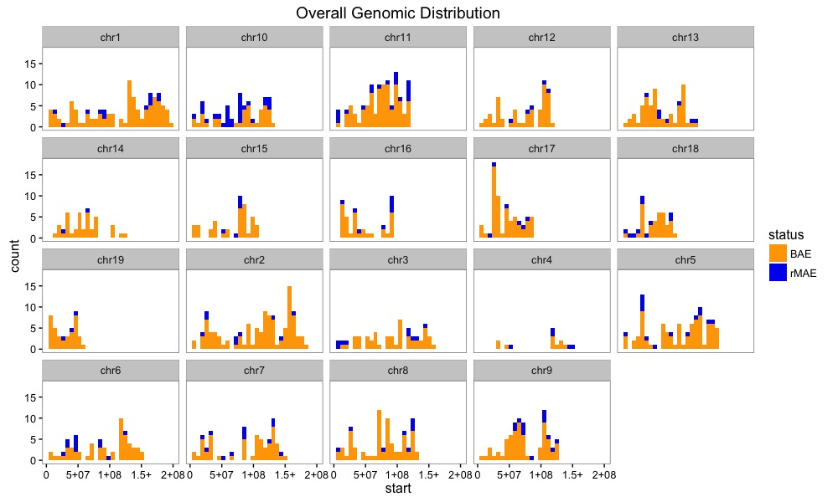
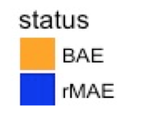
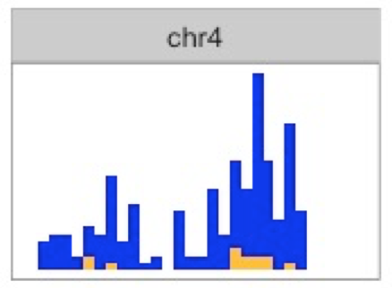
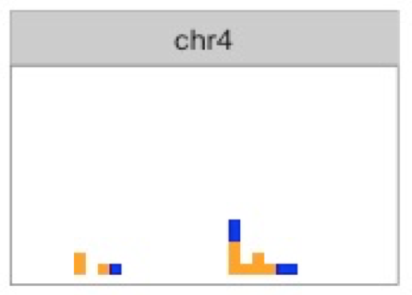
Identifying confounding allelic bias
Data: Nag et al. 2015
Notes:
Identifies that we found artifacts in which there was 100% allelic bias on many genes in chromosome 4 due to a confounding experimental variable
3

Slide 14
Summer Goals
MaGIC 1.0
Trained on limited human data
Only included one silencing mark (H3K27me3)
Messy user-interface and pipeline
Train on better data from mice
Add additional features to improve classification accuracy and draw conclusions
Create an updated machine learning model and package it into user-friendly software for widespread use
Notes:
Train a machine learning classification algorithm on better data
Add additional predictors that may improve classification accuracy and further explain MAE/BAE
Create an updated machine learning model and package it into a
CURRENT STATE VS GOALS
MAGIC 1.0: Trained on human data, works on mouse, trained on only one silencing mark, very “not user friendly”
GOALS: train on mouse data, train on additional set of features with more silencing marks, create a user-friendly pipeline

Slide 15
Adding new features
ChIP-Seq and MAP-Seq data from mouse, primary B-cells
H3k27me3: Yue F, Cheng Y, Breschi A, Vierstra J et al. A comparative encyclopedia of DNA elements in the mouse genome. Nature 2014 Nov 20
H3k36me3: Yue F, Cheng Y, Breschi A, Vierstra J et al. A comparative encyclopedia of DNA elements in the mouse genome. Nature 2014 Nov 20
H3k9me2: Choukrallah MA, Song S, Rolink AG, Burger L et al. Enhancer repertoires are reshaped independently of early priming and heterochromatin dynamics during B cell differentiation. Nat Commun 2015 Oct 19
H3k9me3: Santoni de Sio FR, Massacand J, Barde I, Offner S et al. KAP1 regulates gene networks controlling mouse B-lymphoid cell differentiation and function. Blood2012 May 17
5mCpG methylation: Deaton AM, Webb S, Kerr AR, Illingworth RS et al. Cell type-specific DNA methylation at intragenic CpG islands in the immune system. Genome Res 2011
Notes:
List all datasets. I can replace this with just the GSM numbers. Explain why we chose these new marks. We are adding new features that are associated with epigenetic silencing because previously only 27 was associated
Use machine learning slide as a “home slide”
Important things to mention: from primary cells
2

Slide 16
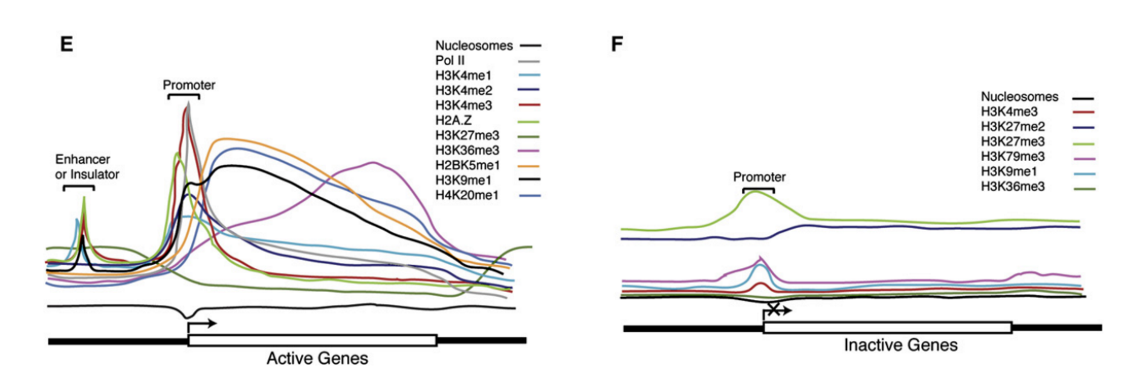
Separating promoter and gene body regions as features
Different epigenetic signatures have different effects in promoter regions vs gene bodies
Li et al., 2012
Notes:
Grab graphic from UCSC genome browser, show a track and then show. Different marks have different factors
2
Put refeerence

Slide 17
Summer Goals
MaGIC 1.0
Trained on limited human data
Only included one silencing mark (H3K27me3)
Messy user-interface and pipeline
Train on better data from mice
Add additional features to improve classification accuracy
Create an updated machine learning model and package it into user-friendly software for widespread use
Notes:
Train a machine learning classification algorithm on better data
Add additional predictors that may improve classification accuracy and further explain MAE/BAE
Create an updated machine learning model and package it into a
CURRENT STATE VS GOALS
MAGIC 1.0: Trained on human data, works on mouse, trained on only one silencing mark, very “not user friendly”
GOALS: train on mouse data, train on additional set of features with more silencing marks, create a user-friendly pipeline

Slide 18
MaGIC 2.0 pipeline flow
Predict MAE
Scores + predictions
Bigwig to counts
Input folder
OR
Mark
Control
Scores
Mark
Control
Normalize scores
Mark
Control
Bigwig files
Generate classifiers
Join input
Notes:
Mention that we have both promoter vs genebody in every output file
3

Slide 19
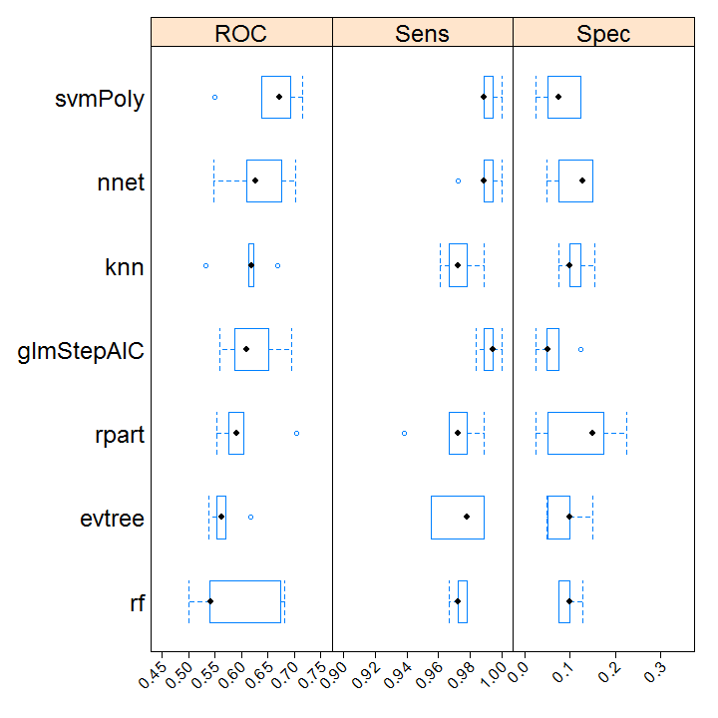
Which model?
all marks,
resampled
training data
Notes:
Add the title to be more punchliney—nnet and knn is better
1 content 3
-Can use 5mCpG enrichment divided by CpG density or CpG methylated density
-Add genomic features potentially could be more informative
-Use looser criteria on testing data from Nag
-2 papers (genddrell) that have multiple clones (NPC) → potentially six clones (availability of chromatin marks? K9 exists) (mouse neuronal progenitor cells) → so we can take raw genes
-Re process Abelson or NPC

Slide 20
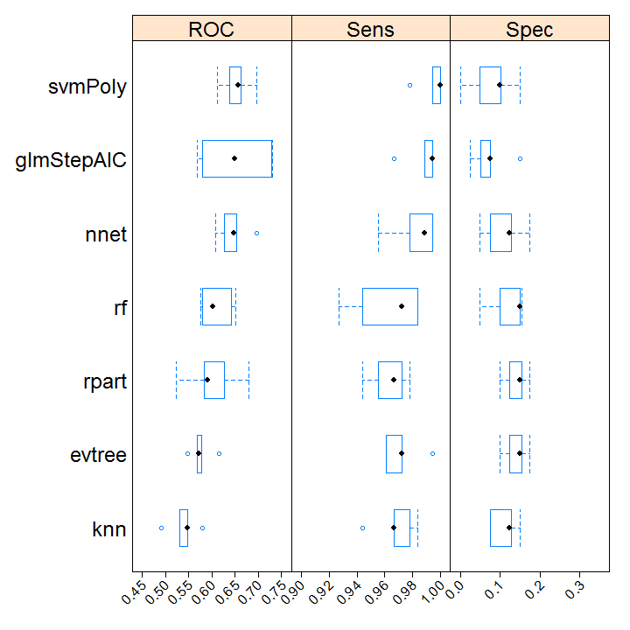
Which model?
H3k27me3 and
H3k36me3
Notes:
Have two different thrsholds: Very few false positives, capture overall gene count
Good way to send:
-Confusion Matrix
-Bar graphs
-True negative and true values
-R markdown
-Downsampling in R
-Null information rate
-Only using one layer

Slide 21
Prediction results (all marks)
Notes:
3
Place to look for human: ENCODE, NIH Epigenetic Roadmap
MAGIC 1 Benchmark, FIGURE 1 or 2 of G3 paper using K36
Running Fibroblasts (look up new marks)
Abl and Fibroblasts are doable, Human LCLs are doable (waiting on NPC and more Abl clones)
GM12878 --> prioritize for human data
Overlap of Genes being called BAE and MAE (we may be capturing a different subset of genes) → tackling potential groupings of MAE → big table
-Update database → new tool, added new data
-Update with better predictions
-Update with more cell types and ChIP seq data from Epigenome roadmap in humans
-Update with confidence score
-Run on a lot of clonal human data replicate and make sure that genes being call are consistent across → eliminate technical noise of the ChIP seq
MINIMAL SET OF FEATURES
CLEAN UP PIPELINE 2. AGREE ON 2 BEST MODELS
DATABASE OR SOFTWARE PAPER?
FINISH ON HUMAN REPLICATE DATA

Slide 22
Prediction results (h3k36me3 and h3k27me3)
Notes:
3

Slide 23
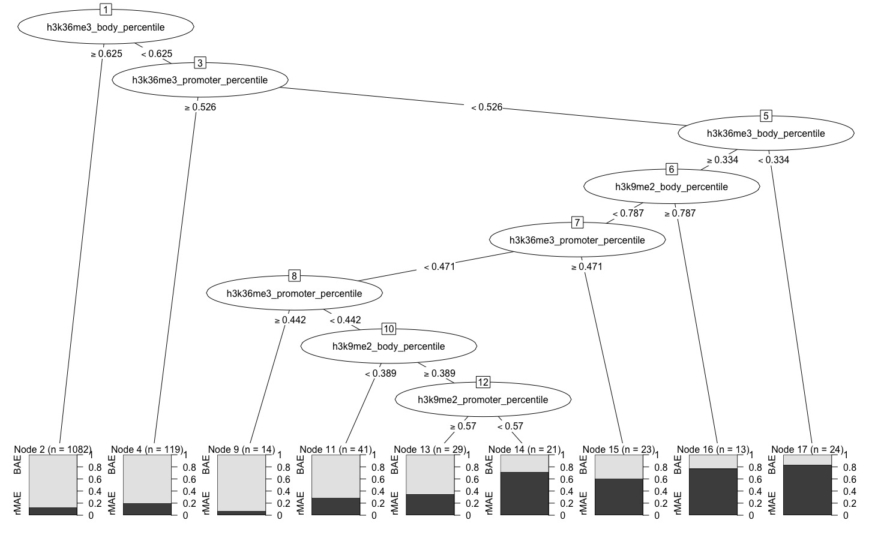
Exploratory feature selection
Feature | P-value
5mCpG promoter | 0.834
5mCpG body | 0.204
H3k27me3 promoter | 0.121
H3k27me3 body | 0.054
H3k36me3 promoter | 0.292
H3k36me3 body | 3.11e-07
H3k9me2 promoter | 0.3486
H3k9me2 body | 0.44
= decision based on H3k36me3
Notes:
H3k36me3 seems to be the main predictive force behind classifying MAE and BAE
1

Slide 24
Conclusions
Positives: higher accuracy (~84%) across all machine learning models compared to MaGIC 1.0, identifies more rMAE genes correctly
Clear problems: very low specificity and AUC values across all the machine learning models tested indicate many missing rMAE genes
Based on feature selection, H3K36me3 gene body seems to be the most significant predictor
H3K9me2 and CpG methylation do not increase predictive power drastically
Preliminary model selection: Recursive Partitioning Decision Tree
Notes:
3
Be ready for questions on elements of this slide: knn etc.

Slide 25
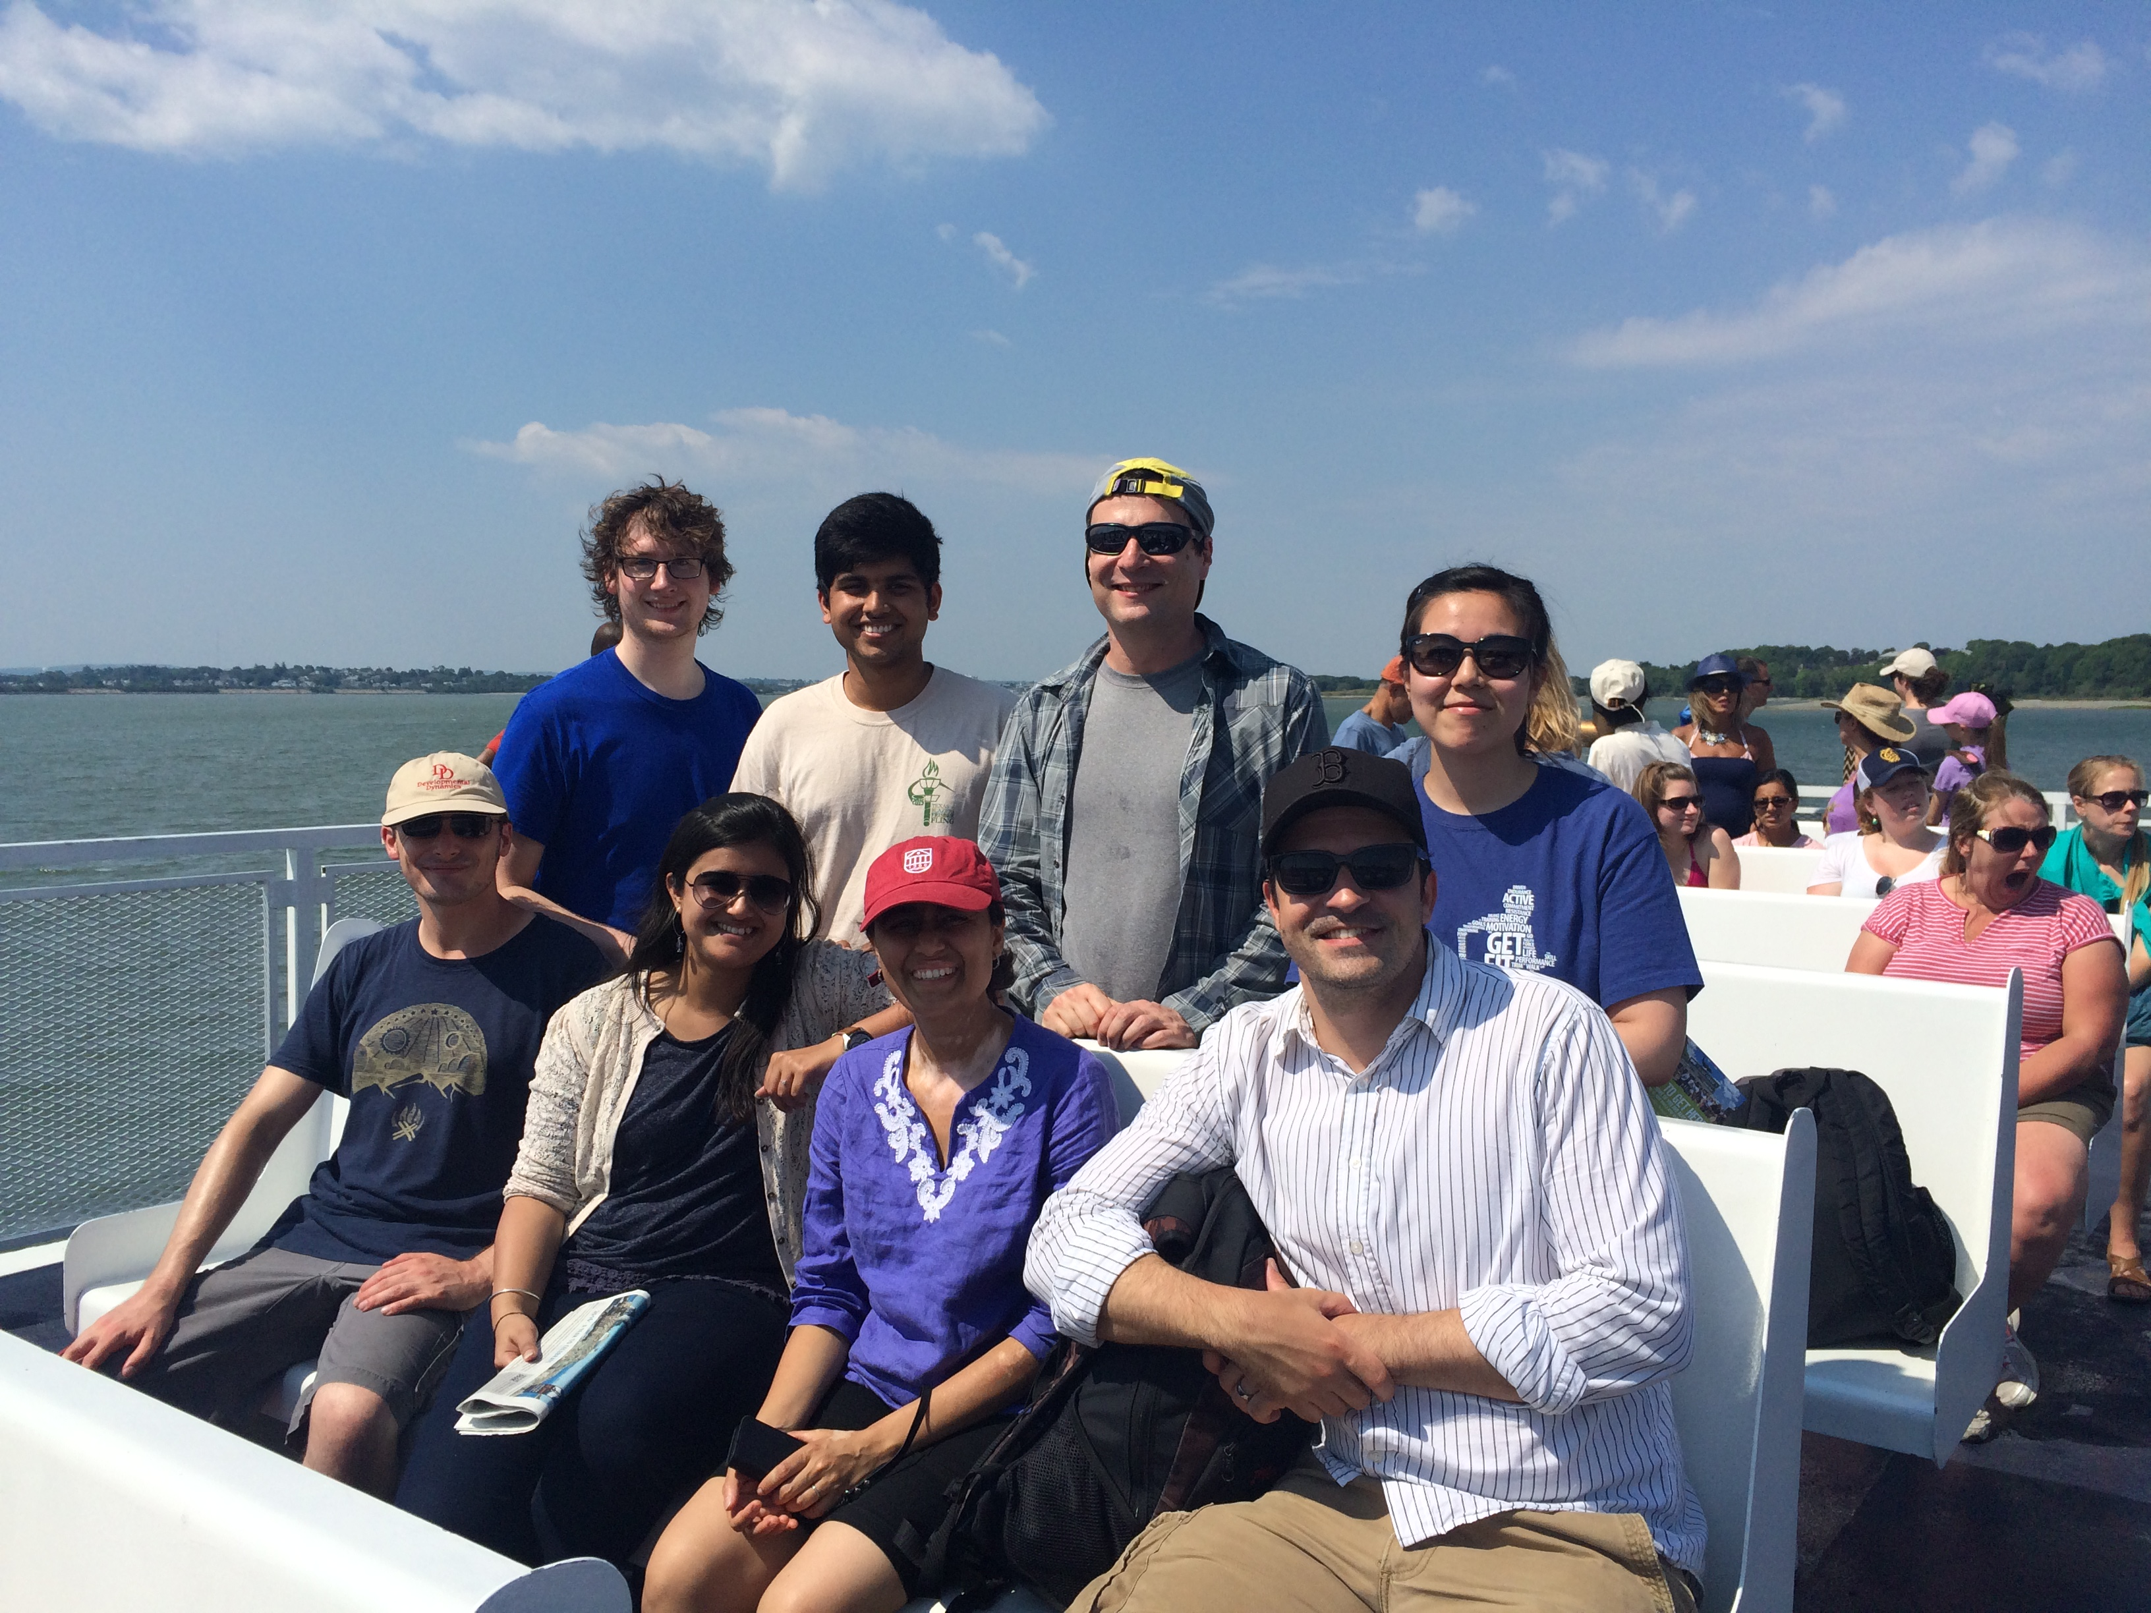
Acknowledgements
Sasha Gimelbrant and Sébastien Vigneau for their thoughtful mentorship and guidance, as well as the other Gimelbrant lab members
Susanne Churchill, Barbara Mawn, Jean Fan and others at HMS DBMI
Domnique Altarejos at Harvard-MIT HST Summer Institute
Dana-Farber Cancer Institute

Slide 26
Future Goals
Predict MAE
Scores + predictions
Bigwig to counts
Input folder
OR
Mark
Control
Scores
Evaluate more epigenetic marks using the MaGIC 2.0 pipeline
Evaluate classifier across cell types and species
Compare chromatin signature of autosomal MAE and X-inactivated genes
Determine if chromatin signature varies with allelic bias
Release pipeline as software
Mark
Control
Normalize scores
Mark
Control
Bigwig files
Generate classifiers
Join input

Slide 27
Negative control
model | accuracy | kappa
rf | 0.904 | 0
nnet | 0.904 | 0
rpart | 0.904 | 0
svmPoly | 0.904 | 0
Models trained on three classes can’t identify MAE
Can models trained on BAE/MAE classes identify MAE?
all marks,
3 classes (MAE, BAE, undecided)
Kappa/specificity values above 0 indicate biological relevance

